Slide 1
Tracking water wastage using IoT
By:
Sourish Vijayamadhavan
Niranjan Prasad J N
Nirmal Kishore A
Abhishek R

Slide 2

திருவள்ளுவர்
INTRODUCTION
குறள் :20
அதிகாரம்: வான்சிறப்பு:
நீர்இன்று அமையாது உலகெனின் யார்யார்க்கும் வான்இன்று அமையாது ஒழுக்கு.
விளக்கம்:
எப்படிப்பட்டவர்க்கும் நீர் இல்லாமல் உலக வாழ்க்கை நடைபெறாது என்றால், மழை இல்லையானால் ஒழுக்கமும் நிலைபெறாமல் போகும்
மு.வரதராசன்

Slide 3
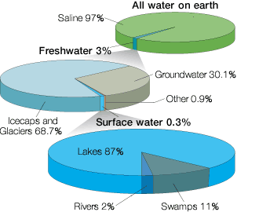
WATER AN OVERVIEW

Slide 4
Introduction
Project objective - Use Sensors & Internet of Things to measure and provide information to the user
Portable water wastage can be attributed to
Mechanical Failures
Transit Wastage &
Negligence
Solution focus on addressing Mechanical Failures Wastage & Negligence Wastage

Slide 5
SOLUTION OUTLINE
Water wastage can be classified into 2 parts: 1. Wastage due to tank overflow 2. Wastage due to injudicious water usage
Water wasted due to tank overflow can be measured, by attaching a flow sensor to the overflow pipe and measuring water flowing through it when tank is filled , as measured by ultrasonic sensor.
In order to measure injudicious water usage, we use information from the Ministry of Housing and Urban Affairs to benchmark the litres per capita per day (lpcd) value at 135
This value is then fixed as the threshold weekly water consumption, and any excess water consumed is regarded as wastage

Slide 6
TABLE OF CONTENTS
01
02
03
ABOUT THE PROJECT
MAJOR REQUIREMENTS
PROJECT GOALS
An IoT based system involving a hall effect flow sensor and an Ultrasonic sensor connected to ThingSpeak server to measure level of water wastage at home.
Flow Sensor
ESP8266 board
Breadboard
Connecting wires
Ultrasonic sensor
Measuring tank water level
Measuring amount of water used via pipes
Detecting leakage in pipes
Calculating waste water based on average water usage
Sending results to the consumer

Slide 7
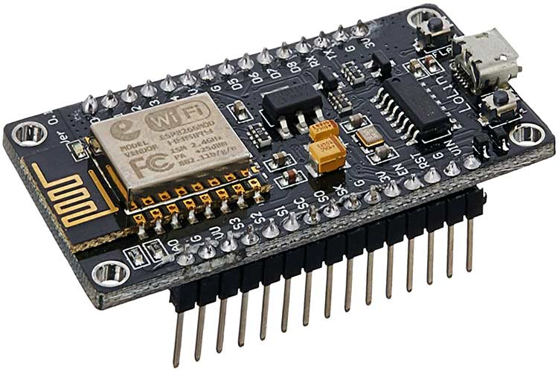
NodeMcu - ESP 8266
What is NodeMcu - ESP 8266?
NodeMCU is an open-source Lua based firmware and development board specially targeted for IoT based Applications.

Slide 8
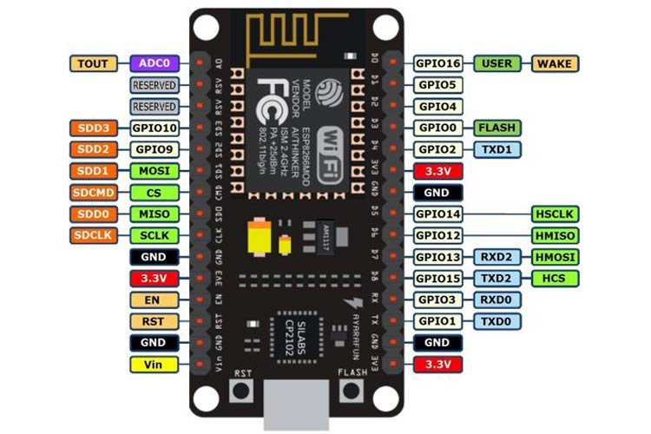
NodeMcu - ESP 8266
NodeMCU ESP8266 Specifications & Features
Operating Voltage: 3.3V
Input Voltage: 7-12V
Digital I/O Pins (DIO): 16 (GPIO)
Analog Input Pins (ADC): 1
Flash Memory: 4 MB
USB port is included onboard.
PCB Antenna
NodeMCU has 128 KB RAM and 4MB of Flash memory to store data and programs.
Its high processing power with in-built Wi-Fi / Bluetooth and Deep Sleep Operating features make it ideal for IoT projects.
NodeMCU can be powered using a Micro USB jack and VIN pin (External Supply Pin).

Slide 9
NodeMcu - ESP 8266
Programming NodeMCU ESP8266 with Arduino IDE
Once Arduino IDE is installed on the computer, connect the board with the computer using the USB cable. Now open the Arduino IDE and choose the correct board by selecting Tools>Boards>NodeMCU1.0 (ESP-12E Module), and choose the correct Port by selecting Tools>Port. To get it started with the NodeMCU board, we may type our usual code that we do in the Arduino IDE.

Slide 10
NodeMcu - ESP 8266
Few Applications of the Board
Prototyping of IoT devices
Low power battery operated applications
Network projects
Projects requiring multiple I/O interfaces with Wi-Fi and Bluetooth functionalities

Slide 11
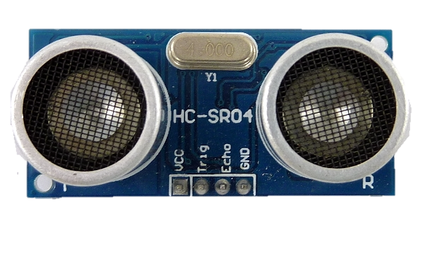
Ultrasonic level sensor
Ultrasonic level sensors measure distance by using ultrasonic waves ( a sound wave at a frequency above the range of human hearing).
The sensor head emits ultrasonic waves and receives the wave reflected back from the target. Ultrasonic level sensors measure the distance to the target by measuring the time between the emission and reception.

Slide 12
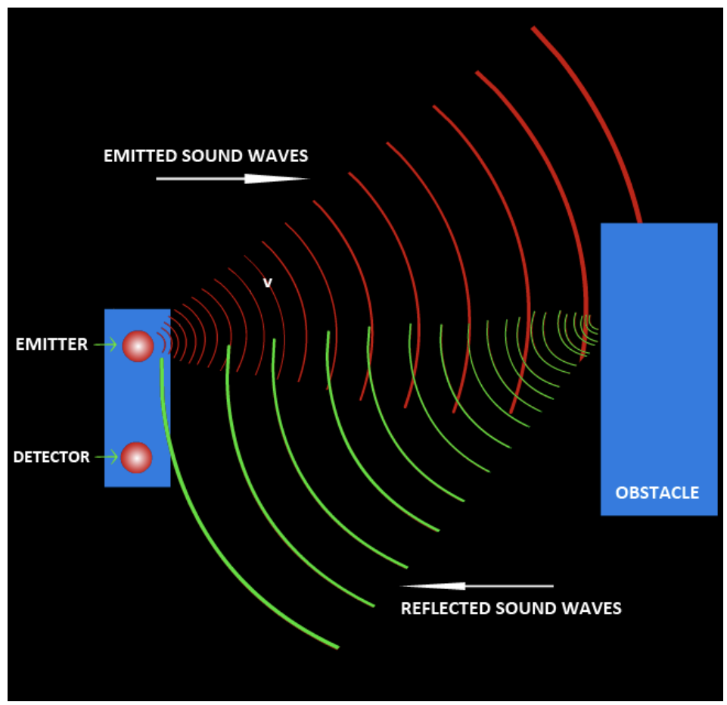
The transducer of the sensor acts as a microphone to receive and send the ultrasonic sound.
Our ultrasonic sensors, like many others, use a single transducer to send a pulse and to receive the echo.
The sensor determines the distance to a target by measuring time lapses between the sending and receiving of the ultrasonic pulse.

Slide 13
Distance = ( Speed of sound in air x time delay) / 2 [distance between the sensor
and the obstacle]
Level = Tank Height – Distance[level of water inside the tank ]

Slide 14
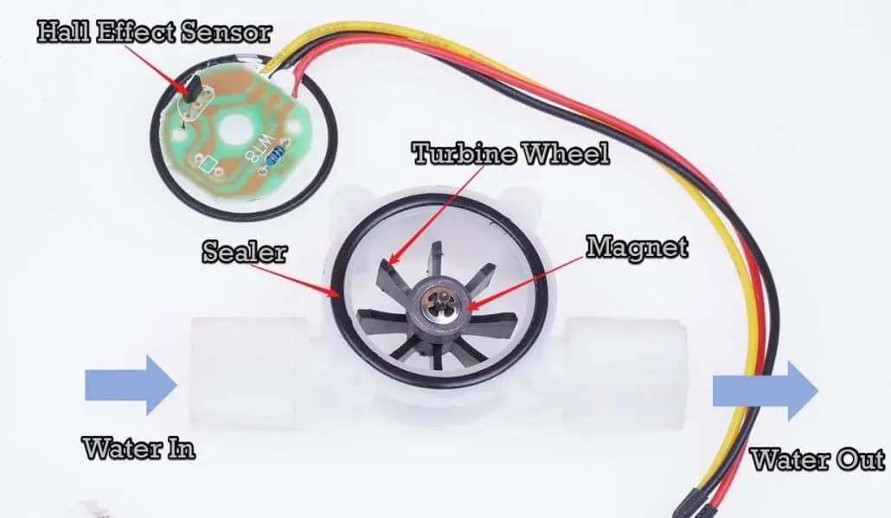
What is a water flow sensor (meter) ?
We use a water flow sensor to measure the water flow rate. The water flow rate is the volume of fluid that passes per unit time.
People often use water flow sensor for automatic water heater control, coffee machines, water vending machines, etc.
There are a variety of flow sensors of different principles, the most common flow sensor is based on a Hall device.
For example, the most classic water flow sensor YF-S402 and YF-S201 rely on Hall sensors.

Slide 15
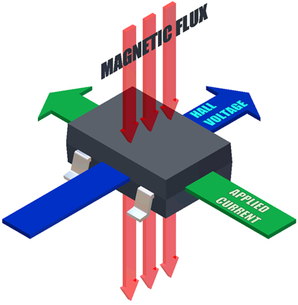
An INTRODUCTION TO Hall effect
The Hall effect is the production of a potential difference across an electrical conductor that is transverse to an electric current in the conductor and to an applied magnetic field perpendicular to the current. It was discovered by Edwin Hall in 1879.

Slide 16
The liquid pushes against the fins of the rotor, causing it to rotate. The shaft of the rotor is connected to a Hall effect sensor. It is an arrangement of a current flowing coil and a magnet connected to the shaft of the rotor, thus a voltage/pulse is induced as this rotor rotates. In this flow meter, if 1 litre of water passes through the sensor every minute, it outputs pulses of frequency 7.5 Hz. This is due to the changing magnetic field caused by the magnet attached to the rotor shaft. We measure the number of pulses using a ESP 8266 and then calculate the flow rate in litres per minutes (L/min) and total volume in Litre using a simple conversion formula.

Slide 17
Model: YF-S201 Sensor Type: Hall effect Working Flow Rate: 1 to 30 Litres/Minute Working Temperature range: -25 to +80℃ Accuracy: ±10%
Pulses per Litre: 450 Maximum water pressure: <=1.75 MPa Flow rate pulse characteristics: Frequency (Hz) = 7.5 * Flow rate (L/min)

Slide 18
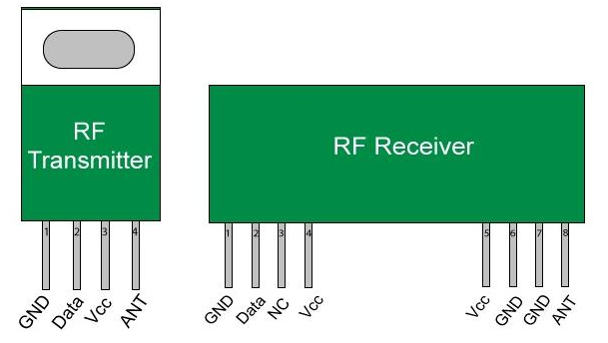
Transfer of information from the sensors to the board
What is RF Module?
As the name suggests, RF module operates at Radio Frequency. This frequency range varies between 30 kHz & 300 GHz. In this RF system, the digital data is represented as variations in the amplitude of carrier wave.
This RF module is a combination of RF Transmitter and RF Receiver. The transmitter/receiver (Tx/Rx) pair operates at a frequency of 433 MHz.
The RF transmitter receives serial data and transmits it wirelessly through its RF antenna. The transmission occurs at the rate of 1 Kbps – 10 Kbps. RF receiver receives the transmitted data and it is operating at the same frequency as that of the transmitter.

Slide 19
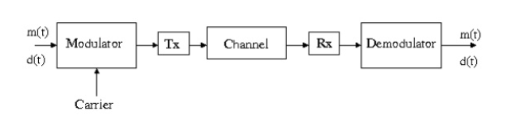
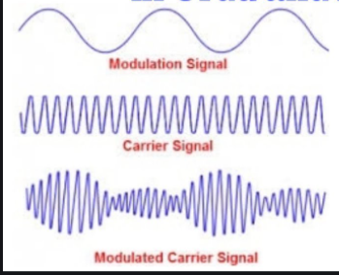
In many projects, we use RF modules to transmitting and receiving the data because it has a high volume of applications than IR. A transmitter can only send information and a Receiver and can only receive it, so data can send from one end to another and not the other way around.
The Transmitter module consists of three pins namely Vcc, Din and ground as shown above. The Vcc pin has a wide range input voltage from 3V to 12V. The center pin is the data pin to transmit the signal. This signal is modulated and then sent on air at a frequency of 433MHz.
RF receiver module has four pins namely Vcc, Dout, Linear out and Ground as shown above. The Vcc pin should be powered with a regulated 5V supply. The pins Dout and Linear out is shorted together to receive the 433Mhz signal from air. This signal is then demodulated to get the data and sent out through the data pin.
Note: Modulation is the process of encoding information in a transmitted signal, while demodulation is the process of extracting information from the transmitted signal.

Slide 20
Analog to digital conversion using Arduino IDE
We have demonstrated analog input usage by reading an analog sensor on analog pin 0 and also printing the corresponding ADC value.
Serial printing is enabled using Serial.begin(baud rate). You can mention the baud rate within the brackets followed by Serial.begin (here 9600).
Serial.print() is used to display the reading of analogRead().
The circuit connection is as given below:
Potentiometer attached to analog input 0
Center pin of the potentiometer to the analog pin
One side pin (either one) to ground
The other side pin to +5V
Digitalout pin to the Rf Transmitter
Rf Transmitter to the central microcontroller.

Slide 21
MEASURING THE TANK LEVEL using ULTRASONIC SENSOR

Slide 22
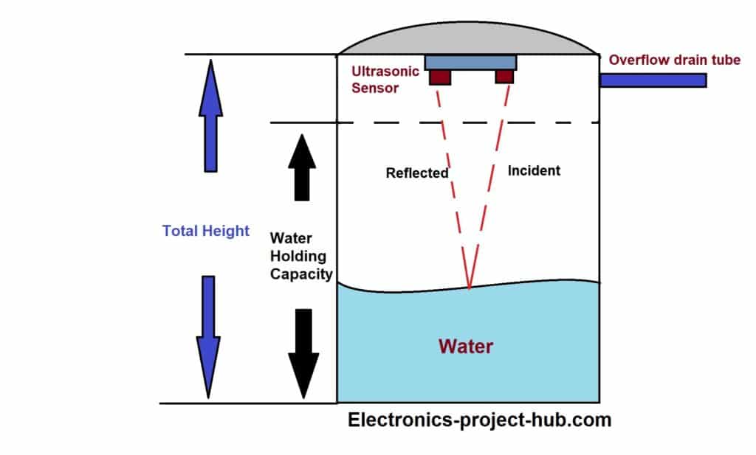

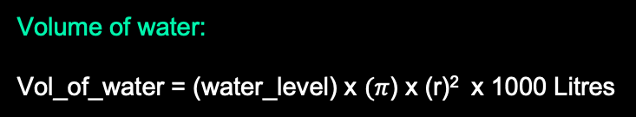
EXPLANATION
In this case the water level as well as the volume
of the water can be measured as follows:
Water Level:
water_level = (Water Holding capacity + h) – ms_value
h
ms_value → Value measured by sensor (in meters)
water_level → level of the water in the tank (in meters)
Volume of water:
Vol_of_water = (water_level) x $(π$) x (r)² x 1000 Litres
r → Radius of the tank (in meters)

Slide 23
MEASURING THE WATER USED USING WATER FLOW METER

Slide 24
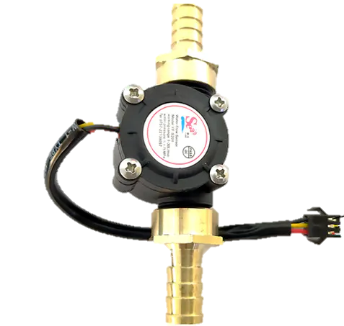
EXPLANATION
We are going to connect the flow meter in the
pipe just before the tap as shown in the figure.
This measures the speed of the water that is
flowing inside the pipe. From that speed we can
calculate the amount of water by multiplying the
flow rate with time.
The amount of water measured in each of the
taps are displayed and intimated to the user at
the end of the day via SMS or e-mail.

Slide 25
MEASURING overflowed water from the tank

Slide 26
Explanation
To find the water that is overflowed
from the tank we are going to connect
another flowmeter to the overflow
pipe.
The amount of water flowed in
overflow pipe is updated in the
ThingSpeak server.
Flowmeter
connected
to this pipe
Thus the amount of water wasted
due to overflow of tank is measured.

Slide 27
FORMULA FOR MEASURING THE FLOW RATE
FLOW RATE = FREQUENCY OF PULSES / 7.5
Flow rate → Speed of water flowing in the pipe (in litre/min)
AMOUNT OF WATER (in Litre):
The Flow rate/60 (litres/seconds) is multiplied with the time (in seconds) in order to get the amount of the water flowed through the pipe in litres.

Slide 28
Explanation-Measuring waste water
So at the end of the day we have the information of the total
water usage by the user. With the help of this information we are
going to measure the amount of waste water by comparing the
total water usage(obtained from our system) with the Average
water usage of per person which is 135 litres per capita per day
(Obtained from the Ministry of Housing and Urban Affairs website).

Slide 29


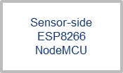
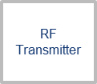
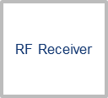
BLOCK DIAGRAM (SENSORS-TO-BOARD)
Hall Effect Flow Sensor
Sensor-side ESP8266 NodeMCU
RF Transmitter
RF Receiver
Centralized ESP8266 NodeMCU
Ultrasonic Level Sensor
WiFi to ThingSpeak

Slide 30
CLOUD PLATFORMS USED

Slide 31
IMPORTANCE OF CLOUD PLATFORM
A cloud platform is essential to analyze and visualize the information gathered from the sensors and provide feedback to the user
ThingSpeak - an open source SaaS cloud platform used especially in IoT systems, uses MATLAB to analyze the flow rate through the pipes and detect any wastage/tank overflow
IFTTT – another cloud platform which provides interconnectivity between applications using applets, that can be designed by the developer
We use ThingSpeak and IFTTT cloud platforms to provide weekly email and real-time SMS notifications to the user

Slide 32
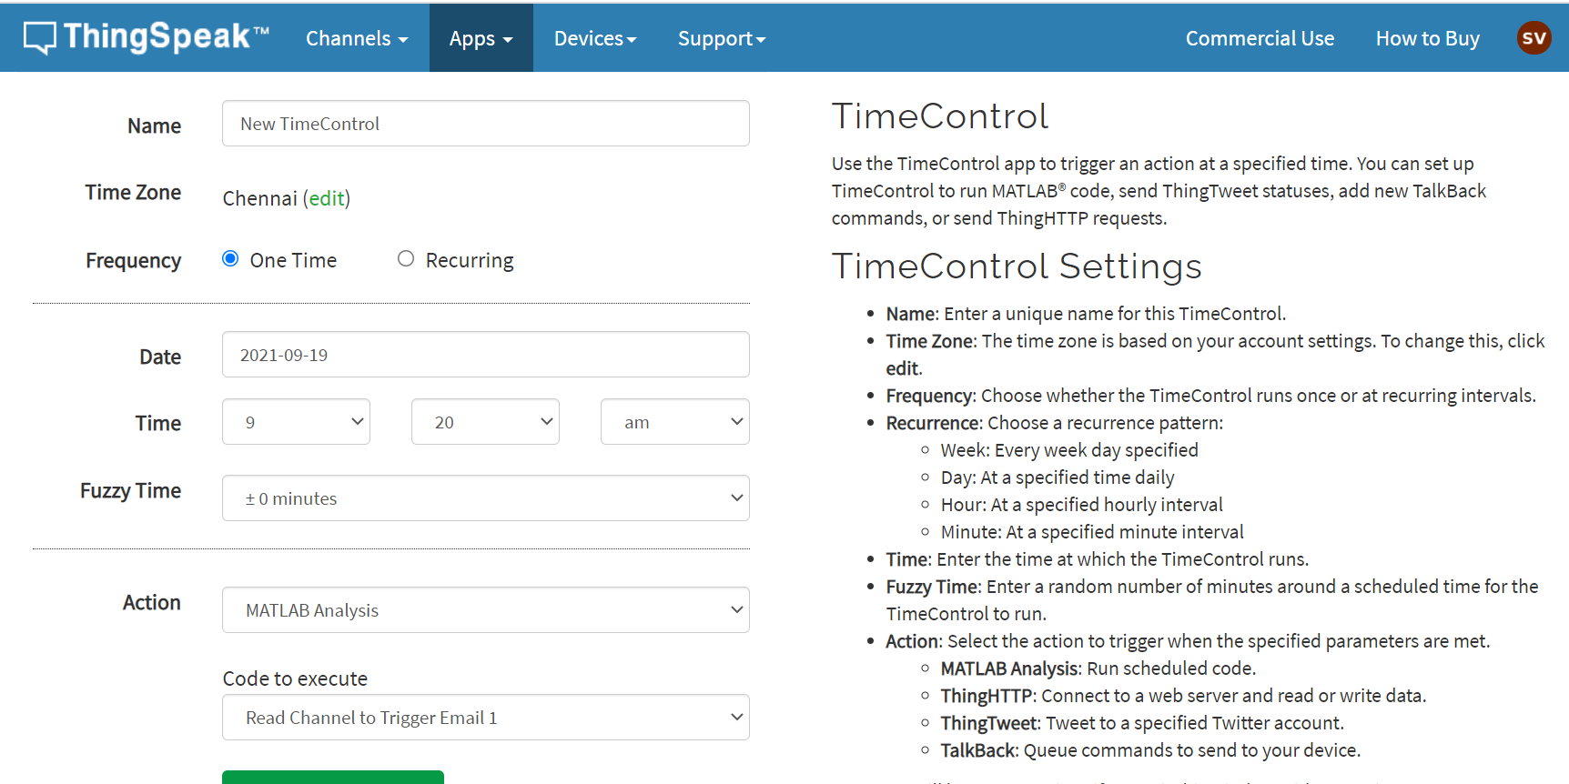
Email notifications using thingspeak
For providing weekly email notifications, we use the following applications inbuilt in ThingSpeak:
TimeControl Application:- Used to perform a certain action periodically (i.e running MATLAB code)
MATLAB Code:- Uses AlertsAPI provided for user account to send email to user’s registered email ID
Interfacing these 2 applications, we can inform the user regarding weekly water wastage, as well as store these emails on an email server for further analysis

Slide 33
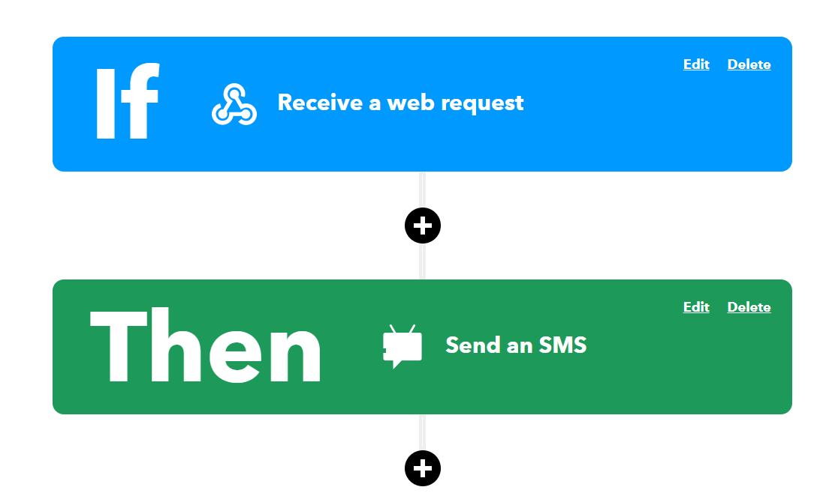
SMS NOTIFICATIONS USING IFTTT
IFTTT enables us to create an applet using the services it provides. An applet consists of 2 parts-a trigger service and action service. When the trigger service is initiated, it causes the action to be completed.
We use the following applications from ThingSpeak and IFTTT to accomplish this.
React:- Compares the value in the channel fields with a condition, and executes an action when the condition is fulfilled
ThingHTTP:- Passes a HTTP GET request to a particular web URL when initiated by React
WebHooks:- An IFTTT service which acts as a trigger whenever it receives a HTTP GET request
AndroidSMS :- An IFTTT service that passes an SMS to the user’s registered Android phone when initiated by WebHooks

Slide 34




Block DIAGRAM (BOARD-TO-USER)
Email Notification (Weekly)
Centralized ESP8266 NodeMCU
TimeControl Appilcation - weekly execute MATLAB Code
MATLAB Code using AlertsAPI key for sending weekly wastage
ThingSpeak Cloud Server Channel
SMS Notification (Real Time)
React Application (reads channel values)
ThingHTTP Application
(sends HTTP GET request)
HTTP GET
WebHooks Service (Triggered by GET request)
AndroidSMS Service (sends SMS to user mobile number)

